Slide 1

Survival Analysis
Online – May 16th 2020
Mohammad Alfan Alfian Riyadi
( Advisor RDKM – DSI East Java Chapter )

Slide 2



About Me
Call Me Alfan !
Education : Bachelor - Statistics 2012-2016
Master - Statistics 2016-2018
Experience : Statistician 2018-2019
Senior Statistician 2020-Now
Activity : Advisor

Slide 3
Outline
Introduction
Survival Function and Hazard Function
Kaplan Meier Curve and Log Rank Test
Regression for Survival Analysis
Cox Proportional Hazard Model
Parametric Survival Analysis Model
Evaluation Models

Slide 4


Slide 5
Introduction
Sometimes we have some questions…….
What is the proportion of a population that will survive beyond a given time?
Among those who survive, at what rate will they die or fail?
Is it reasonable to consider multiple causes of death or failure?
How does the probability of survival vary with respect to particular circumstances or characteristics?
Is there any dependency among event times of interest and other explanatory variables?

Slide 6
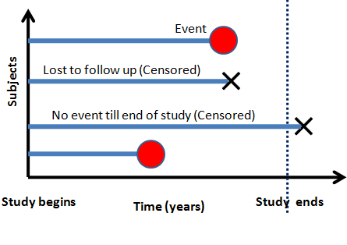
Introduction
Object
Event
Time
Lifetime
Censoring Time
Failure
Fault
Random Variable

Slide 7


Introduction
Some useful library in R
survival
survminer
Books

Slide 8
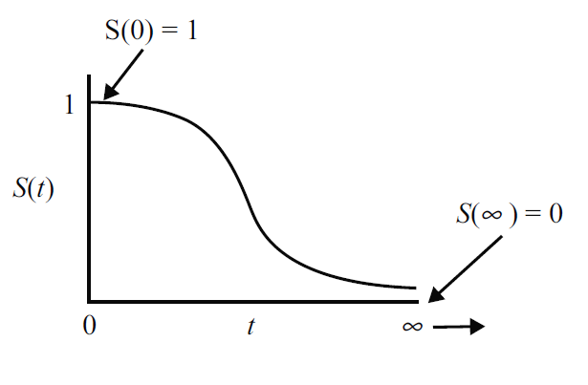
Survival Function and Hazard Function
What is Survival Function????
“A function that gives the probability that a patient, device, or any object of interest will survive beyond any specified time”

Slide 9
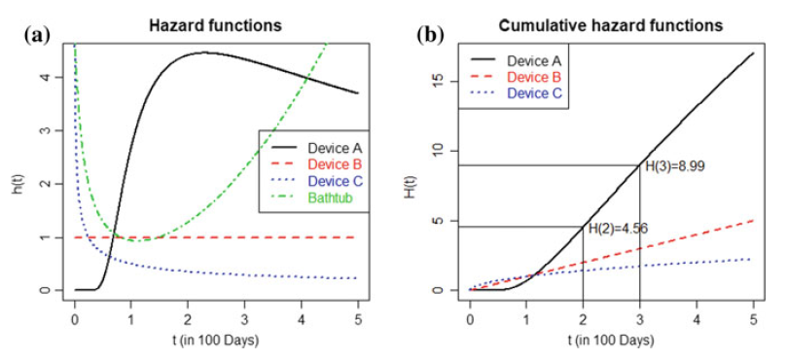
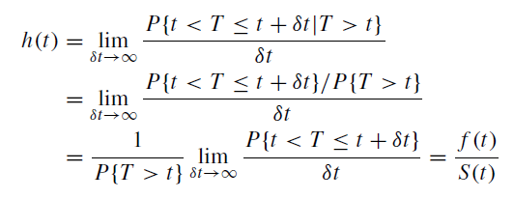

Survival Function and Hazard Function
What is Hazard Function????
“The instantaneous potential per unit time for the event to occur, given that the individual has survived up to time t”
Cumulative Hazard Function:

Slide 10
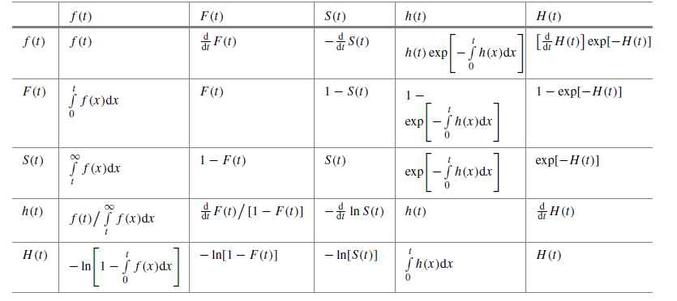
Survival Function and Hazard Function
Relationship Survival Function and Hazard Function

Slide 11
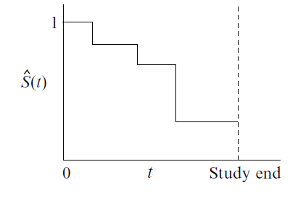
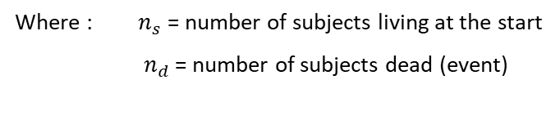

Kaplan Meier Curve and Log Rank Test
Actual
Estimate
“The Kaplan–Meier estimator is a non-parametric statistic used to estimate the survival function from lifetime data”
$$\hat{S}\left(t\right)=\frac{n_{s}−n_{d}}{n_{s}}$$
Where : $n_{s}$ = number of subjects living at the start
$n_{d}$ = number of subjects dead (event)

Slide 12
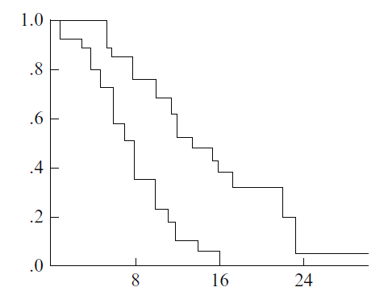
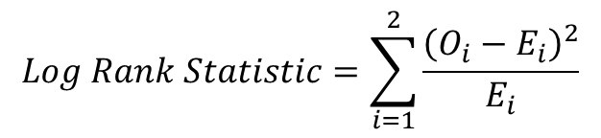

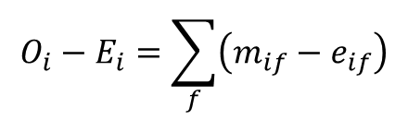
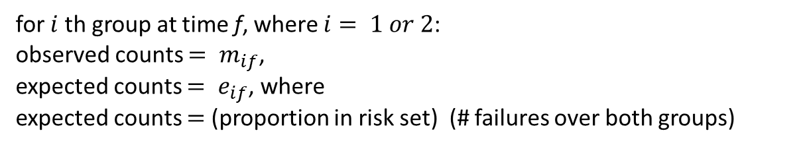
Kaplan Meier Curve and Log Rank Test
“Log rank test is a test for compare survival distribution for 2 sample groups of data”
$$Log Rank Statistic=\sum_{i=1}^{2}{\frac{{\left(O_{i}−E_{i}\right)}^{2}}{E_{i}}}$$
$$O_{i}−E_{i}=\sum_{f}{\left(m_{if}−e_{if}\right)}$$
for $i$ th group at time f, where $i= 1 or 2$:
observed counts $= m_{if}$,
expected counts $= e_{if}$, where
expected counts $=$ (proportion in risk set) (# failures over both groups)
Log-rank statistic $\sim χ^{2}$ with 1 df under H0.

Slide 13
Regression for Survival Analysis
Parametric
Exponential
Weibull
Log Logistic
Multiperiod Logistic
Etc.
Semi Parametric
Cox Proportional Hazard
Non Parametric
Neural Network
SVM
Random Forest
Deep Learning
Etc.

Slide 14
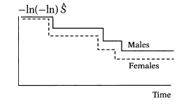
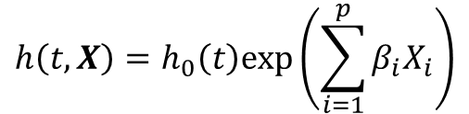
Regression for Survival Analysis
Cox Proportional Hazard (Cox Regression)
$$h\left(t,X\right)=h_{0}\left(t\right)exp⁡\left(\sum_{i=1}^{p}{β_{i}X_{i}}\right)$$
Baseline Hazard
(Doesn’t require any specified distribution)
Is it parrarel or not?
Main Assumption :
Hazard ratio comparing any two specifications of predictors is constant over time

Slide 15
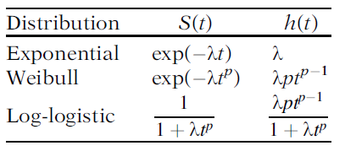

Regression for Survival Analysis
Parametric Survival Analysis
Main Assumptions:
Follow specified distribution
Ratio of survival times is assumed constant for all fixed values of S(t)
$$λ=exp⁡\left(\sum_{i=1}^{p}{β_{i}X_{i}}\right)$$

Slide 16
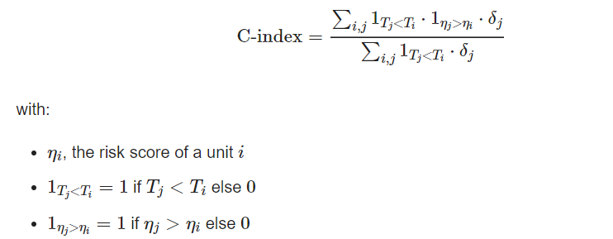

Evaluation Metrics
Some evaluation metrics are commonly used
C-Index
Source : https://square.github.io/pysurvival/metrics/c_index.html
Brier Score
Source : https://square.github.io/pysurvival/metrics/brier_score.html

Slide 17



Thank You and Let’s Practice
https://medium.com/@alfanstatistika
https://www.linkedin.com/in/mohammad-alfan-alfian-riyadi/

